Slide 1
Sixth Edition
Chapter 3
Defining and Measuring
Variables

Slide 2
3.1 Constructs and Operational Definitions (1 of 2)
Third step in the research process:
  Determining a method for defining and measuring the variables being studied
  Variables: characteristics or conditions that change or have different values for different individuals

Slide 3
3.1 Constructs and Operational Definitions (2 of 2)
Types of variables involved in research
  Well-defined, easily observed, and easily measured
    Examples: height and weight
  Intangible, abstract attributes
    Examples: motivation or self-esteem
    Measurement is more complicated.
    How to measure?

Slide 4
Operationalization
How would you define…
  Extraversion?
  Anxiety?
  Aggression?

Slide 5
Theories and Constructs
Theory: a set of statements
  About mechanisms underlying a particular behavior
What are constructs (hypothetical constructs)?
  Hypothetical entities created from theory and speculation
    Cannot be seen, but are assumed to exist
    Help explain and predict behavior in a theory
    Examples?

Slide 6
Measurement
Careful, deliberate observations of the real world
  Purpose: Describing objects and events in terms of the attributes composing the variable.
  Needs to be purposeful/deliberate! Pick your measurements w/ care!
  Traits can have many dimensions!

Slide 7
Dimensions Example
Trait: Extraversion
  Possible Dimensions?
    Outgoing
    Leadership
    Assertiveness

Slide 8
Limitations of Operational Definitions
An operational definition is not the same as the construct itself.
Concerns about the quality of operational definitions and measurements produced
  It is easy for operational definitions to leave out important components of a construct.
  Operational definitions often include extra components that are not part of the construct being measured.

Slide 9
Validity and Reliability of Measurement
Researchers have developed two general criteria for evaluating the quality of any measurement procedure.
  Validity and reliability

Slide 10
Consistency of a Relationship (1 of 3)
Demonstrating consistency
  Plot scores for two measures on a scatterplot
    Positive relationship: the two measurements change together in the same direction.
    Negative relationship: the two measures change in opposite directions.

Slide 11
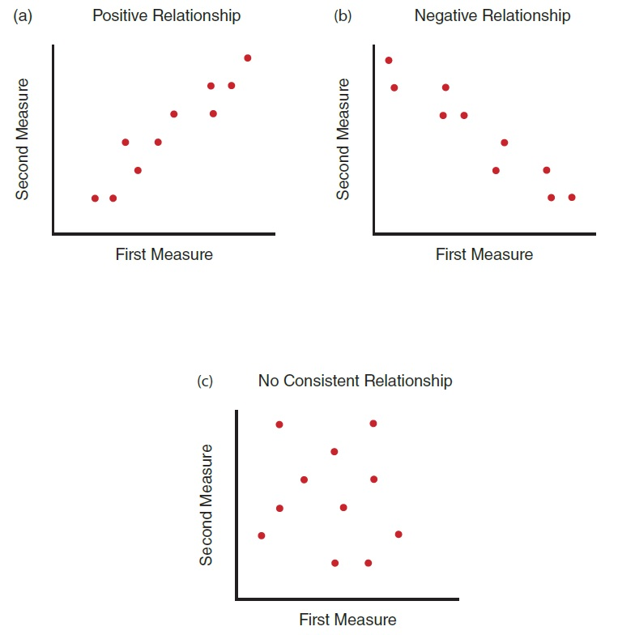
Consistency of a Relationship (2 of 3)
Notes:
Figure 3.1 Scatter Plots Showing Different Relationships
Positive relationship
Negative relationship
No consistent relationship
NOTE: For the first measure, values increase from left to right. For the second measure, values increase from bottom to top.

Slide 12
Consistency of a Relationship (3 of 3)
Determine the consistency of a relationship by computing a correlation between the two measures
  Consistent positive relationship: a correlation near +1.00
  Consistent negative relationship: a correlation near −1.00
  Inconsistent relationship: a correlation near zero.

Slide 13
Validity of Measurement (1 of 4)
To establish validity
  Measurement procedure must accurately capture the variable that it is supposed to measure.
    Example: Does an IQ test measure intelligence accurately?
    How to test this?

Slide 14
Validity of Measurement (2 of 4)
Face validity: simplest and least scientific
  Whether a measure superficially appears to measure what it claims to measure
Concurrent validity
  Scores obtained from a new measure
    Directly related to scores obtained from a more established measure of the same variable
    Correlate them!
Notes:
Definitions of Validity

Slide 15
Validity of Measurement (3 of 4)
Predictive validity
  Scores obtained from a measure accurately predict behavior according to a theory.
Construct validity
  Scores obtained from a measurement behave exactly the same as the variable itself.
Notes:
Definitions of Validity

Slide 16
Validity of Measurement (4 of 4)
Convergent validity
  Strong relationship between the scores obtained from two (or more) different methods of measuring the same construct
Divergent validity
  Showing little or no relationship between the measurements of two different constructs
Notes:
Definitions of Validity

Slide 17
Reliability of Measurement (1 of 2)
Stability or consistency of the measurements produced by a specific measurement procedure
Concept of reliability
  Inconsistency of a measurement comes from error
  Measured score = True score + error

Slide 18
Reliability of Measurement (2 of 2)
Sources of errors:
  Observer error
    The individual who makes the measurements can introduce simple human error.
  Environmental changes
    It is difficult to attain the ideal identical circumstances.
  Participant changes
    The participant can change between measurements (e.g., degree of focus).

Slide 19
Testing Reliability (1 of 2)
Successive measurements
  Test-retest reliability: compares scores of two successive measurements of the same individuals and correlates the scores.
    Parallel forms reliability
Simultaneous measurements
  Inter-rater reliability: agreement between two observers who simultaneously record measurements of the behaviors.

Slide 20
Testing Reliability (2 of 2)
Internal consistency
  Split-half reliability: splits the test in half computing a separate score for each half, and then calculating the degree of consistency between the two scores for a group of participants

Slide 21
The Relationship Between Reliability and Validity
Reliability is a prerequisite for validity.
  A measurement procedure cannot be valid unless it is reliable.
A measurement can be valid without being reliable.
  Consistency of measurement is no guarantee of validity.

Slide 22
Scales of Measurement
Measurement is a procedure for classifying individuals.
  Scale of measurement is the set of categories used for classification.
The process of measurement involves two components:
  Set of categories
  Procedure for assigning individuals to categories.

Slide 23
Four Types of Measurement Scales
Nominal scale
  Represents qualitative differences in the variable measured
Ordinal scale
  Represents differences in a series of ranks
Interval and ratio scales
  Consist of a series of equal intervals like the inches on a ruler
  A ratio scale has a true zero value.

Slide 24
Dealing With Equivocal Measurements
Interval or ratio scale scores are:
  Compatible with basic arithmetic
  Suitable for statistical analysis (e.g., mean and variance) ► allow hypothesis testing.
Scores from an ordinal scale are not:
  Compatible with basic arithmetic or appropriate for statistical analysis.
Distinction of a measure as an interval and ratio is not always clear cut.

Slide 25
Selecting a Scale of Measure
What is the scale’s ability in comparing different measurements?
  Nominal: reveals whether a difference exists
  Ordinal: indicate the direction of the difference (which is more and which is less)
  Interval: determines the direction and the magnitude of a difference
  Ratio: determines the direction, magnitude, and ratio of a difference

Slide 26
Modalities of Measurement (1 of 2)
Self-report measures ask participants direct questions to study behavior.
  Provides a direct measure
  validity is dubious… Why?
Physiological measures are based on manifestations of the underlying construct.
  e.g., MRIs
  Provide objective measures
  Require expensive equipment; may not provide valid measures of constructs
  Potential problems?

Slide 27
Modalities of Measurement (2 of 2)
Behavioral measures are based on overt behaviors that can be observed and measured.
  Provide researchers with a vast number of options
    Possible to select the behavior(s) that seems to be best for defining and measuring the construct
    Examples?
  Behaviors may be only a temporary or situational indicators of an underlying construct.

Slide 28
Other Aspects of Measurement
Multiple measures provide more confidence in the validity of the measurements.
  Can introduce problems
    Complex statistical analysis and interpretation
    Lack of agreement between two measures
  Method for limiting problems
    Combine the measures into a single score or each individual

Slide 29
Sensitivity and Range Effects
Range effect: a measurement that is not sensitive enough to detect a difference
  Ceiling effect: clustering of scores at the high end of a measurement scale
    Allowing little or no possibility of increases in value
  Floor effect: clustering of scores at the low end of a measurement scale
    Allowing little or no possibility of decreases in value

Slide 30
Artifacts: Experimenter Bias and Participant Reactivity
Artifact: a non-natural feature accidentally introduced into something being observed
  Experimenter bias: measurements are influenced by the experimenter’s expectations regarding the outcome of the study.
  Participant bias: Outcome is influenced based on participants’ expectations

Slide 31
Limiting Experimenter Bias
Standardize or automate the experiment
Single-blind study
  The research study is conducted by an experimenter who does not know the expected results.
Double-blind study
  Neither the experimenter nor the participants know the expected results of the study.

Slide 32
Demand Characteristics and Participant Reactivity
Demand characteristics refer to any of the potential cues or features of a study that:
  suggest to the participants the purpose and hypothesis of the study, and
  influence the participants to respond or behave in a certain way.
Reactivity
  Participants modify their natural behavior in response to knowing they are in a study.

Slide 33
Types of Participants
Good subject
  Supports the experimenter’s hypothesis
Negativistic subject
  Acts contrary to the hypothesis
Apprehensive subject
  Presents himself in a “good light”
Faithful subject
  Follows instructions to the letter (ideal participant)

